Slide 1
Semaphores

Slide 2
Semaphores
A positive integer (including zero) manipulated by two operations
P operation on semaphore s
  Waits until s is greater than zero and then decrements s by one and allows the thread to continue
V operation on semaphore s
  Increments s by one and releases one of the waiting threads (if any)
P and V are atomic operations

Slide 3
Semaphores
Devised by Dijkstra in 1968
  Letter P from Dutch word passeren, meaning “to pass”
  Letter V from Dutch word vrijgeven, meaning “to release”

Slide 4
P and V as atomic actions
Suppose a semaphore s has the value 1, and two threads simultaneously attempt to execute P on s
  only one of these operations will be able to complete before the next V operation on s;
  the other thread attempting to perform a P operation is suspended.

Slide 5
V on binary semaphores
A general semaphore can have any non-negative value; a binary semaphore is one whose value is always 0 or 1
we will assume that a V operation on a binary semaphore which has value 1 does not increment the value of the semaphore
in general, if a semaphore has its maximal value, the increment does not succeed.

Slide 6
Mutual Exclusion
Semaphore S = 1 // initial value of semaphore is 1
Thread 1:
P(S);
count++;
V(S);
}
Thread 2:
P(S);
count++;
V(S);

Slide 7
Pthread interface
sem_t: data type for semaphores
sem_init(sem_t *s, 0, 1);
  initializes the semaphore pointed to by s to 1
P → int sem_wait(sem_t *s)
V → int sem_post(sem_t *s)
  Other interfaces call it sem_signal()

Slide 8
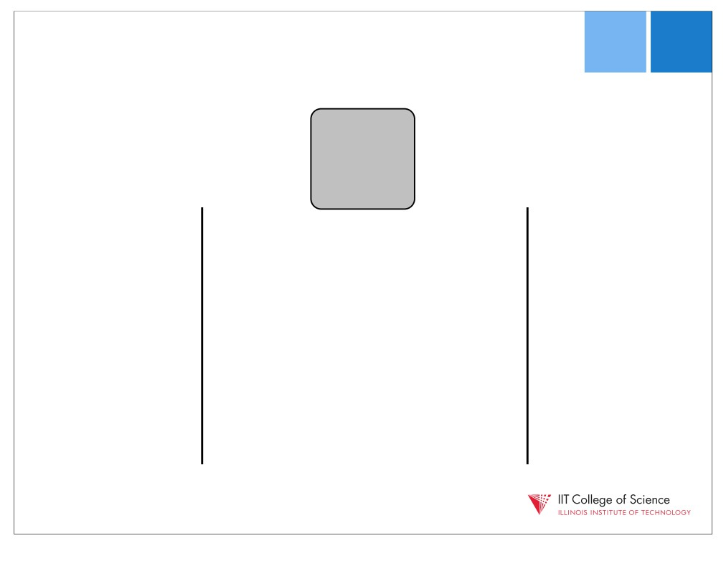
1
T1
T2

Slide 9

1
T1
T2
sem_wait(sem)

Slide 10

1
T1
T2
--
sem_wait(sem)

Slide 11
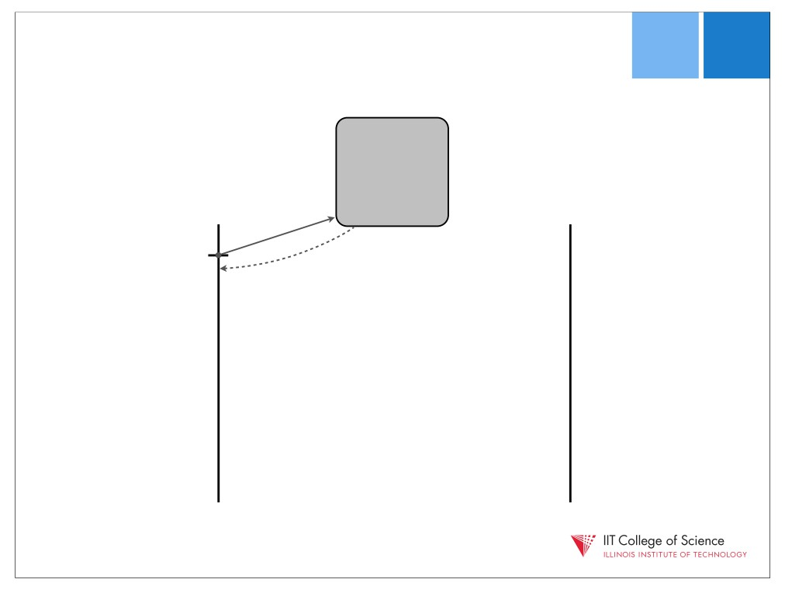
0
T1
T2
--
sem_wait(sem)

Slide 12
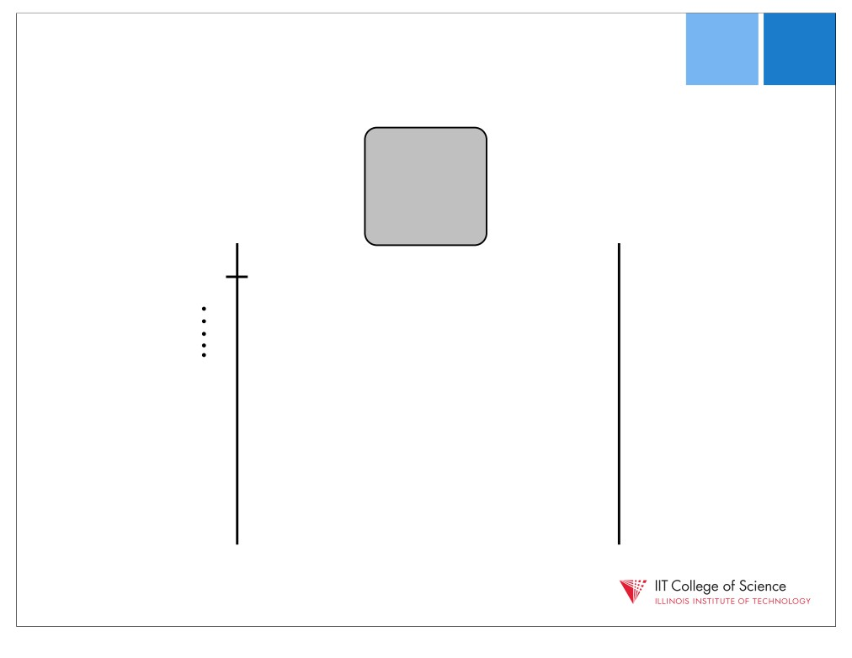
0
T1
T2
sem_wait(sem)

Slide 13

0
T1
T2
sem_wait(sem)
sem_wait(sem)

Slide 14

0
T1
T2
--
sem_wait(sem)
sem_wait(sem)

Slide 15
0
T1
T2
--
sem_wait(sem)
blocks!
(no return)
sem_wait(sem)

Slide 16
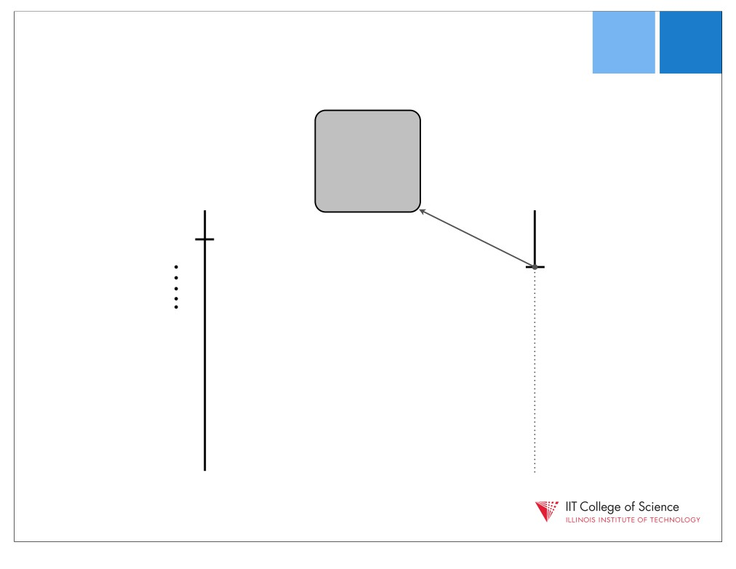
0
T1
T2
sem_wait(sem)
sem_wait(sem)

Slide 17

0
T1
T2
sem_wait(sem)
sem_wait(sem)
sem_post(sem)

Slide 18

0
T1
T2
sem_wait(sem)
++
sem_wait(sem)
sem_post(sem)

Slide 19

1
T1
T2
sem_wait(sem)
++
sem_wait(sem)
sem_post(sem)

Slide 20

0
T1
T2
sem_wait(sem)
++
unblocks!
sem_wait(sem)
sem_post(sem)

Slide 21
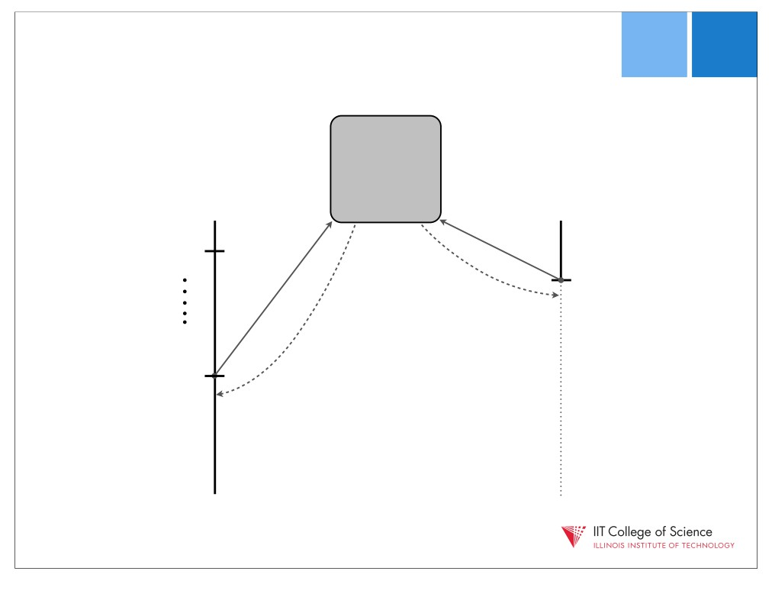
0
P1
P2
sem_wait(sem)
++
unblocks!
sem_wait(sem)
sem_post(sem)

Slide 22
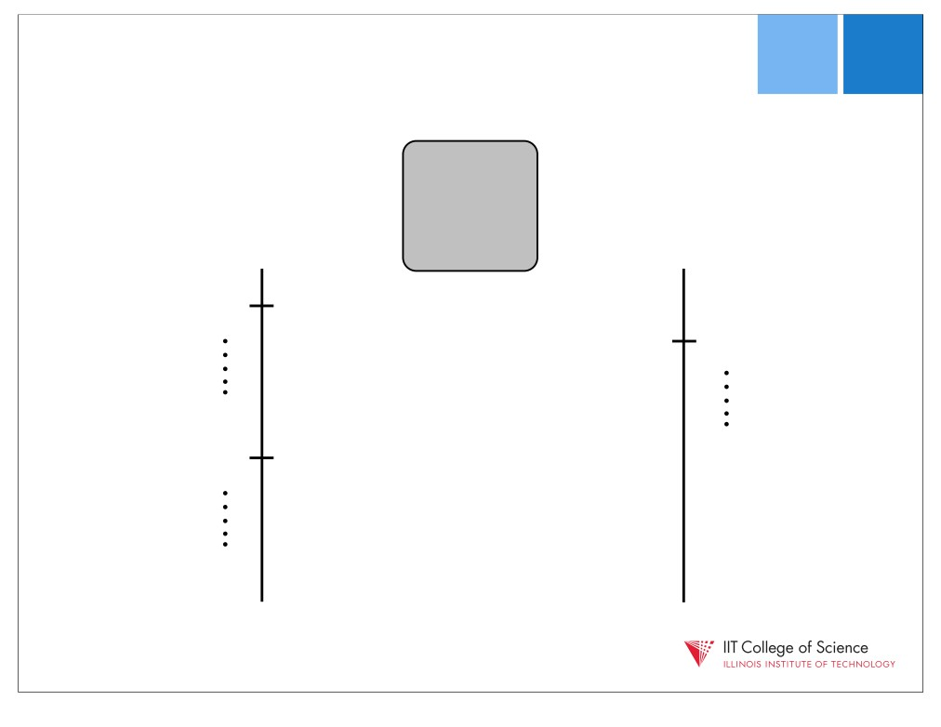
0
T1
T2
sem_wait(sem)
sem_wait(sem)
sem_post(sem)

Slide 23

0
T1
T2
sem_wait(sem)
sem_wait(sem)
sem_post(sem)
sem_post(sem)

Slide 24

0
T1
T2
sem_wait(sem)
sem_wait(sem)
++
sem_post(sem)
sem_post(sem)

Slide 25

1
T1
T2
sem_wait(sem)
sem_wait(sem)
++
sem_post(sem)
sem_post(sem)

Slide 26

1
T1
T2
sem_wait(sem)
sem_wait(sem)
sem_post(sem)
sem_post(sem)

Slide 27
Practice exercise
sem r = 0, s = 1;
Thread T1:
P(r);
P(s);
A1;
V(s);
A2;
V(r);
Thread T2:
B1;
V(r);
B2;
P(s);
B3;
V(s);
True or False: Operation A1 cannot start until operation B1 is complete.

Slide 28
Practice exercise
sem r = 0, s = 1
Thread T1:
P(r);
P(s);
A1;
V(s);
A2;
V(r);
Thread T2:
B1;
V(r);
B2;
P(s);
B3;
V(s);
True or False: Operations A1 and B2 cannot execute concurrently.

Slide 29
Practice exercise
sem r = 0, s = 1
Thread T1:
P(r);
P(s);
A1;
V(s);
A2;
V(r);
Thread T2:
B1;
V(r);
B2;
P(s);
B3;
V(s);
True or False: Operations A1 and B3 cannot execute concurrently.

Slide 30
Practice exercise
sem r = 0, s = 1
Thread T1:
P(r);
P(s);
A1;
V(s);
A2;
V(r);
Thread T2:
B1;
V(r);
B2;
P(s);
B3;
V(s);
True or False: Operations A2 and B3 cannot execute concurrently.

Slide 31
Condition synchronization
Threads may need to communicate about events
  “has event A already happened in another thread?”
  aka “precedence constraint”, or “scheduling constraint”
    Do B after A
semaphores are not only useful for enforcing mutual exclusion, but can be used for enforcing execution order

Slide 32
Execution order
Thread A Thread B
Requirement
  guarantee that a1 happens before b1
To guarantee a1 < b1
  B has to wait until A executes a1
  … then A needs to signal B that it can execute b1
  Can we solve this using semaphores?
1. statement a1
1. statement b1

Slide 33
Execution order
Thread A Thread B
To guarantee: a1 < b1
  Create a semaphore, named aDone that indicates whether thread A has completed a1
  B has to wait until A executes a1
    so, let B issue P(&aDone) before b1
  … then A needs to signal B that it can execute b1
    so, let A issue V(&aDone) after a1
1. statement a1
1. statement b1

Slide 34
Execution order
Thread A Thread B
How should we initialize ?
  aDone = 1 does not work
  aDone = 0 works
statement a1
V(&aDone)
P(&aDone)
statement b1

Slide 35
Practice Exercise
Thread A Thread B
Requirement
  guarantee that a1 happens before b1
  guarantee that b1 happens before a2
statement a1
Statement a2
1. statement b1

Slide 36
Practice Exercise
Thread A Thread B
We need to guarantee: a1 < b1, b1 < a2
Does this work?
Broken solution
  B must do its P operation before A reaches its P operation
  What can we do to fix this?
statement a1
V(&Done)
P(&Done)
statement a2
P(&Done)
statement b1
V(&Done)

Slide 37
Practice Exercise
Thread A Thread B
We need to guarantee: a1 < b1, b1 < a2
  In writing your solution, be sure to specify the names and initial values of your semaphores (little hint here)
  Now solve it!
statement a1
statement a2
statement b1

Slide 38
Practice Exercise
Thread A Thread B
Guarantee: a1 < b1, b1 < a2
Idea: A waits for B using a different semaphore
  Is this finally correct?
statement a1
V(&aDone)
P(&bDone)
statement a2
P(&aDone)
statement b1
V(&bDone)

Slide 39
Practice exercise (1)
Thread T1:
print(R);
print(OK);
Thread T2:
print(I);
print(OK);
Thread T3:
print(O);
print(OK);
Add operations on semaphores such that
The result printed is R I O OK OK OK
The final value of the semaphores is identical to their initial value

Slide 40
Solution (1)
sem a,b,c = 0;
Thread T1:
print(R);
V(a);
P(c);
print(OK);
Thread T2:
P(a);
print(I);
V(b);
P(c);
print(OK);
Thread T3:
P(b);
print(O);
V(c);
V(c);
print(OK);

Slide 41
(2) Practice exercise (2)
Consider the following two threads:
Add semaphores such that the string printed is: ABABABA…
Thread T1:
while (1) {
print(A);
}
Thread T2:
while (1) {
print(B);
}

Slide 42
Solution (2)
sem s1 = 1; s2 = 0;
Thread T1:
while (1) {
P(s1);
print(A);
V(s2);
}
Thread T2:
while (1) {
P(s2);
print(B);
V(s1);
}

Slide 43
Practice exercise
Thread T1:
while (1) {
print(A);
V(c);
P(a);
}
Thread T2:
while (1) {
print(B);
V(c);
P(b);
}
Thread T3:
while (1) {
P(c);
P(c);
print(C);
V(a);
V(b);
}
Assuming semaphores a, b, c are initialized to 0, what strings can be printed?

Slide 44
What is a deadlock?
A deadlock is when a set of threads are permanently blocked
  Unblocking of one relies on the progress of another
  But none can make progress!
Deadlock is bad!

Slide 45
Practice Exercise
Thread 1:
Thread 2:
sem_t t; // t = 1
P(&s)
P(&t)
sem_t s; // s = 1
P(&t)
P(&s)
do_work();
V(&t)
do_work();
V(&s)
V(&s)
V(&t);
Will this always deadlock? Sometimes deadlock? Never deadlock? Show execution order for possible cases.

Slide 46
Thread 1:
Thread 2:
P(&s)
P(&t)
sem_t t; // t = 1
sem_t s; // s = 1
P(&t)
P(&s)
do_work();
V(&t)
do_work();
V(&s)
OK:
V(&s)
V(&t);
T1 T2
P(&s)
Deadlock:
P(&t)
T1 T2
P(&s)
do_work()
V(&t)
P(&t)
V(&s)
P(&s)
P(&t)
P(&t)
P(&s)
T1,T2 stuck!

Slide 47
Rendezvous
Thread A Thread B
Requirements
  guarantee that a1 happens before b2
  guarantee that b1 happens before a2
  we don’t care about the order of a1 and b1
statement a1
statement a2
statement b1
statement b2

Slide 48
Rendezvous
Requirement: a1 < b2, b1 < a2
Idea: use two semaphores
  lets call them aArrived, bArrived
  both initialized to 0
Thread A Thread B
This solution works, right?
statement a1
V(&x)
P(&y)
statement a2
statement b1
V(&y)
P(&x)
statement b2

Slide 49
Rendezvous
Requirement: a1 < b2, b1 < a2
You might have tried …
Thread A Thread B
This solution also works, right?
statement a1
V(&x)
P(&y)
Statement a2
statement b1
P(&x)
V(&y)
Statement b2

Slide 50
Rendezvous
Requirement: a1 < b2, b1 < a2
You might have tried …
Thread A Thread B
Why is this a flawed solution?
  Assuming A arrives first, it will block at its P
  When B arrives, it will also block, since A wasn’t able to signal aArrived
  So, neither thread can proceed, and never will
statement a1
P(&y)
V(&x)
statement a2
statement b1
P(&x)
V(&y)
statement b2

Slide 51
Semaphores vs. mutexes
A mutex is initially unlocked
  Semaphores can be initialized to any value, including 0
  A semaphore initialized to zero corresponds to an initial locked state
A mutex can only assume two states, unlocked and locked
  A semaphore is a counter

